Slide 1

AIR POLLUTION ANALYSIS IN HYDERABAD

Slide 2
Agenda
1. What is Air Pollution and Problem Statement.
2. Data Frame Information.
3. Data Cleaning.
4. Analysis according to problem Statement.
5. Observations for each analysis.
6. Recommendations.

Slide 3
Air Pollution:
Air pollution refers to the presence of harmful substances in the atmosphere,
such as gases, dust, smoke, or chemicals, that can negatively affect human health, the environment, and the climate. These pollutants can be natural or man-made and are typically released by vehicles, industries, construction activities, and burning of fossil fuels.
Problem Statement:
This study aims to analyze air pollution trends in Hyderabad from January to August 2023 by identifying the most affected locations, determining the months and times of day with the highest pollution levels, comparing pollution levels between weekdays and weekends, and recognizing the most commonly occurring air pollutants across all monitoring areas.
Dataset: https://data.telangana.gov.in

Slide 4
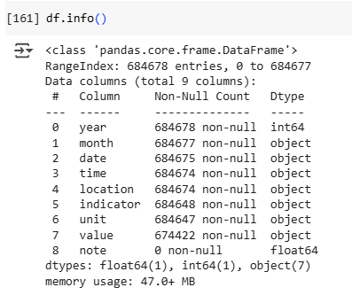
Data Frame Information

Slide 5
Data Cleaning
Drop Duplicates
Null Values prediction and fill methods
df.isnull().sum()/len(df)*100
df[‘col’]=df[‘col’].fillna(df[‘col’].mean()/mode()/median()
df[‘col’]=df[‘col’].fillna(method=‘ffill’)
df[‘col’]=df[‘col’].fillna(method=‘bfill’)
df.dropna(subset=[‘col’],inplace=True)
Type Conversion
df[“col"]=df[“col"].astype(“int”)
df[“col"]=pd.to_datetime(df[“col"],errors="coerce")
Standardize Text Entries using string methods
df[“col"] = df[“col"].str.strip().str.upper()
Outliers Identification.
IQR
Box plot method
df.duplicated().sum()
df=df.drop_duplicates()

Slide 6
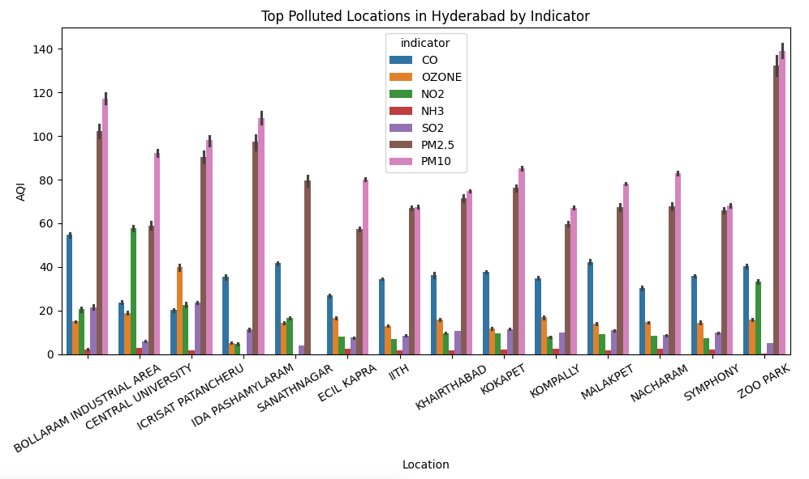
COMPARISON OF AIR QUALITY ACROSS LOCATIONS

Slide 7
Observations:
Most Affected Locations
Bollaram Industrial Area
Zoo Park
IDA Pashamylaram
Patancheru
These areas are likely affected by industrial emissions, vehicular pollution,
and less green cover.
Kompally
It shows the lowest AQI, indicating better air quality, possibly due to lower
traffic, industrial activity, or better ventilation.

Slide 8
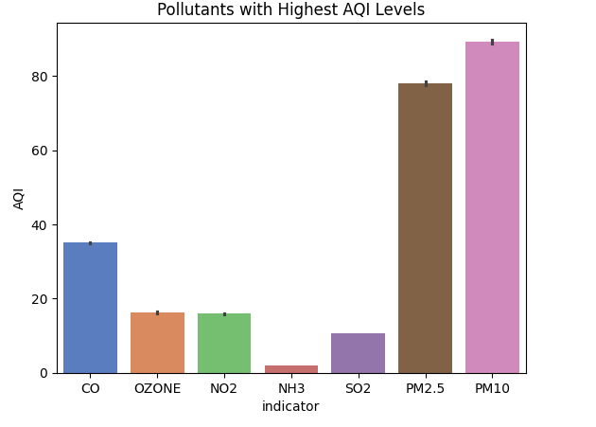
POLLUTANTS WITH HIGHEST AQI LEVELS
Observations
1. PM10 and PM2.5 are the dominant pollutants.
2. CO (Carbon Monoxide) also shows a significant presence.
3. Other pollutants like OZONE, NO2, NH3, SO2 are relatively lower in comparison.

Slide 9
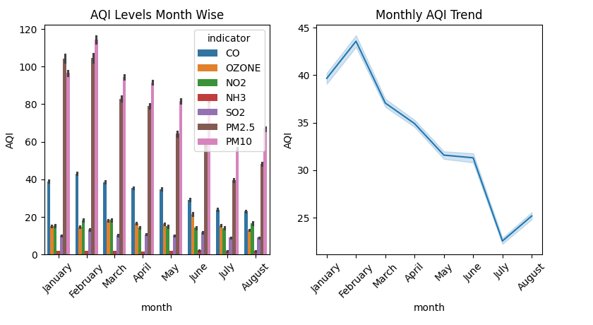
MONTH WISE AQI LEVELS

Slide 10
Observations:
Monthly AQI Trends: AQI peaks in February, possibly due to:
Cooler weather trapping pollutants (temperature inversion).
Increased combustion activities (e.g., heating).
A steady decline is observed from March to July, with a slight rise again in August.
Monsoon influence (starting June) likely helps clear pollutants, improving air quality in July.

Slide 11
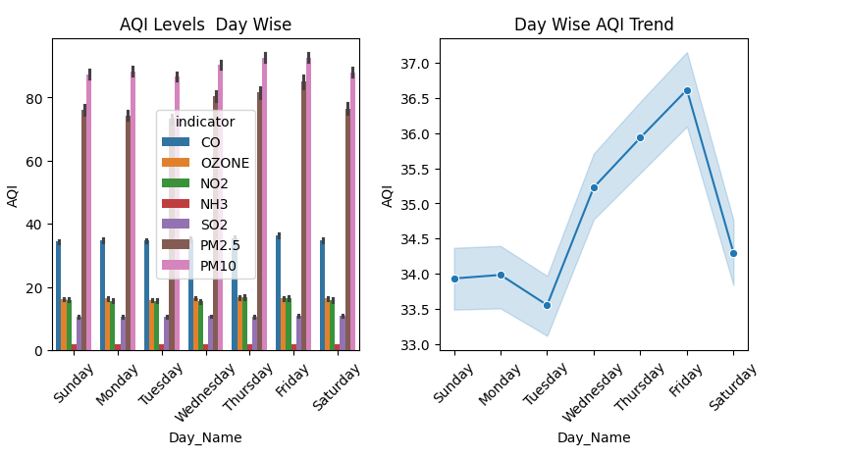
DAY WISE AQI LEVEL AND TREND

Slide 12
Observations
Weekly Cycle: The line plot clearly illustrates a weekly cycle in air quality, with higher pollution levels during the working days and lower levels on the weekend. This pattern likely reflects the changes in human activities throughout the week in Hyderabad.
Weekend Air Quality Improvement: There's a noticeable dip in the overall AQI on Saturday and Sunday, indicating better air quality during the weekend
Mid-Week Peak: The AQI generally increases through the weekdays, reaching its highest point around Thursday or Friday.

Slide 13
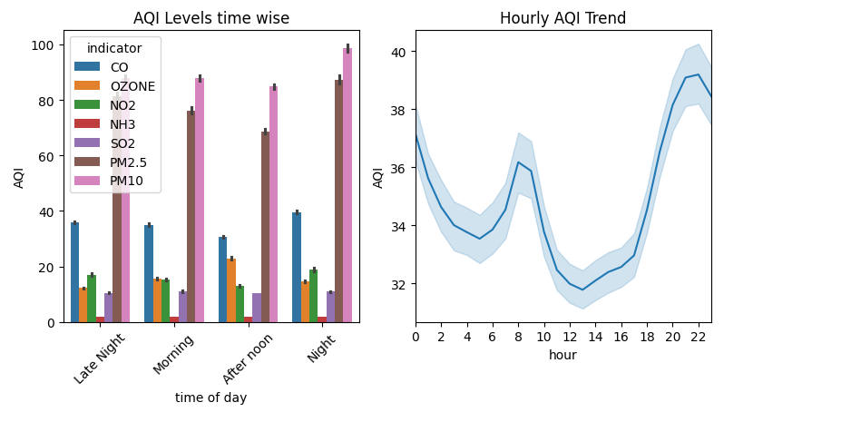
AQI LEVELS TIME WISE

Slide 14
Observations:
Night & Late Night Hours (10 PM – 5 AM): AQI is highest due to low wind, cooler temperatures, and pollutant accumulation.
Morning Hours (6 AM – 10 AM): AQI begins to rise with the start of traffic and daily activities.
Afternoon Hours (10 AM – 3 PM): AQI is lowest—sunlight and wind help disperse pollutants effectively.
Evening Hours (4 PM – 9 PM): AQI increases again due to traffic, reduced dispersion, and cooling temperatures.

Slide 15
Recommendations from AQI Analysis
1. Control pollution in industrial areas like Bollaram, Zoo Park, and Pashamylaram by checking emissions and managing waste properly.
2. Reduce dust and smoke (PM10 & PM2.5) by watering roads, covering construction sites, and using filters in factories.
3. Plant more trees in polluted zones to naturally clean the air.
4. Limit traffic during night and early morning, when pollution is highest, and promote carpooling or public transport.

Slide 16

THANK YOU
Presented by:
Lalitha M
Batch No: 373

